Slide 1
AVA: A Video Dataset of Spatio-temporally Localized Atomic Visual Actions
钱天文
19110860020
2019.11.4

Slide 2
Outline
Introduction of AVA dataset
Basic information
Baseline
Results
A better baseline
Video Transformer Network
Transformer
Architecture
Experiments and Results
Long-term Freature Bank
Architecture
Methods
Experiments
SlowFast Network
Architecture
Experiments

Slide 3
AVA Dataset
Totally 430 15-30 minutes video clips
Splited into 235 training, 64 validation and 131 test videos, roughly a 55:15:30.
The annotation is person-centric at a sampling frequency of 1 Hz, nearly 900 keyframes for each movie.
short segments (±1.5 seconds centered on a keyframe) to provide temporal context for labeling the actions in the middle frame.
annotates 80 atomic visual actions
one action corresponding to the actor’s pose, interactions with objects, actions with other persons
14 pose classes, 49 person-object interaction classes and 17 person-person interaction classes

Slide 4
AVA Dataset
the definition of atomic visual actions, rather than composite actions
Precise spatio-temporal annotations with possibly multiple annotations for each person
exhaustive annotation of these atomic actions over 15-minute video clips
people temporally linked across consecutive segments
Using movies to gather a varied set of action representations
Depart from existing datasets for spatio-temporal action recognition, which typically provide sparse annotations for composite actions in short video clips.

Slide 5
Baseline

Slide 6
Results

Slide 7
A Better Baseline for AVA
Rohit Girdhar¹², João Carreira¹, Carl Doersch¹, Andrew Zisserman¹³
¹DeepMind
²Carnegie Mellon University
³University of Oxford

Slide 8
Architecture and results

Slide 9
Video Action Transformer Network
Rohit Girdhar
Carnegie Mellon University

Slide 10


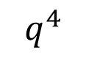


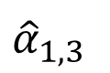
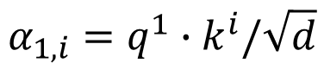

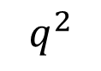


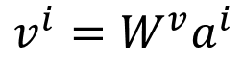

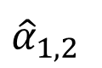
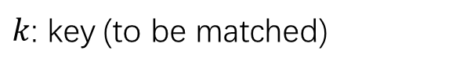



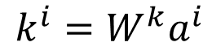

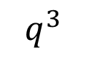

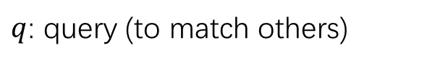
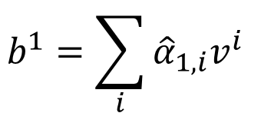

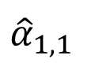
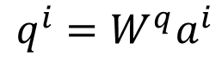

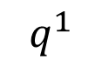



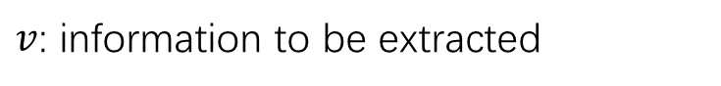
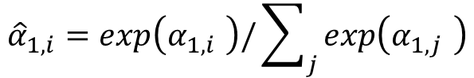
Transformer
$$b^{1}$$
$q$: query (to match others)
$$q^{i}=W^{q}a^{i}$$
$${\hat{α}}_{1,1}$$
$${\hat{α}}_{1,2}$$
$${\hat{α}}_{1,3}$$
$${\hat{α}}_{1,4}$$
$k$: key (to be matched)
$$k^{i}=W^{k}a^{i}$$
$v$: information to be extracted
$$q^{1}$$
$$k^{1}$$
$$v^{1}$$
$$q^{2}$$
$$k^{2}$$
$$v^{2}$$
$$q^{3}$$
$$k^{3}$$
$$v^{3}$$
$$q^{4}$$
$$k^{4}$$
$$v^{4}$$
$$v^{i}=W^{v}a^{i}$$
$$α_{1,i}=q^{1}∙k^{i}/\sqrt{d}$$
$$a^{1}$$
$$a^{2}$$
$$a^{3}$$
$$a^{4}$$
$${\hat{α}}_{1,i}=exp\left(α_{1,i} \right)/\sum_{j}{exp\left(α_{1,j} \right)}$$
$$x^{1}$$
$$x^{2}$$
$$x^{3}$$
$$x^{4}$$
$$b^{1}=\sum_{i}{{\hat{α}}_{1,i}v^{i} }$$

Slide 11
Architecture
The main idea of the original architecture is to compute self-attention by comparing a feature to all other features in the sequence.
query (Q), key (K) and value (V ) tensors: the person being classified is the query, and the clip around the person is the memory, projected into key and values.

Slide 12
Experiments: Action classification given GT person boxes, Localization performance (action agnostic)
Only get a small improvement by using groundtruth (GT) boxes, indicating that it is capable of learning to person detection.
Replace the head architecture with the Action Transformer, which leads to a significant 5% boost for the GT boxes case.
Transformer head actually has 2.3M fewer parameters than the I3D head in the LowRes QPr case, dispelling any concerns that this improvement is simply from additional model capacity.
Drop in performance with and without GT boxes for the Action Transformer is due to only using R = 64 proposals. As will be seen in subsequent results, this drop is eliminated when the full model with R = 300 proposals
I3D head with RPN boxes excels on this task, achieving almost 93% mAP at 0.5 IOU.
Using a lowres query does quite poorly at 77.5%, but by adopting the highres query, the gap in performance is considerably reduced.
Transformer is less accurate for localization and this can be understood by its more global nature.

Slide 13
Results

Slide 14
Visualization

Slide 15
Long-Term Feature Banks for Detailed Video Understanding
Chao-Yuan Wu^{1,2} Christoph Feichtenhofer² Haoqi Fan²
Kaiming He² Philipp Krahenbuhl¹ Ross Girshick²
¹The University of Texas at Austin ²Facebook AI Research (FAIR)

Slide 16
Architecture

Slide 17
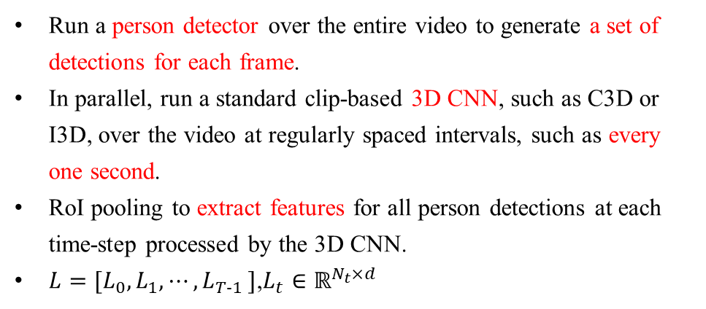
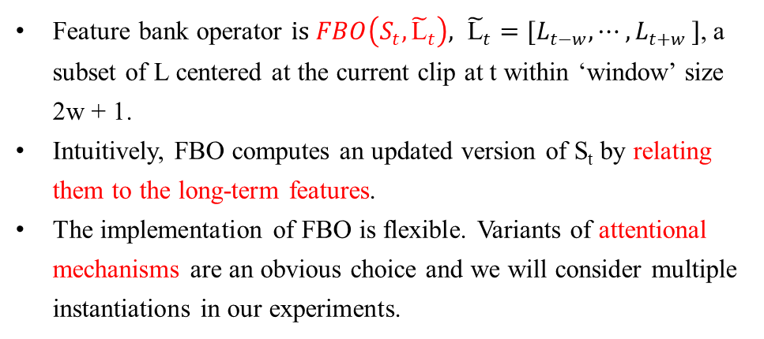
Method
Long-Term Feature Bank
Run a person detector over the entire video to generate a set of detections for each frame.
In parallel, run a standard clip-based 3D CNN, such as C3D or I3D, over the video at regularly spaced intervals, such as every one second.
RoI pooling to extract features for all person detections at each time-step processed by the 3D CNN.
$L=[L_{0},L_{1},{⋯,L}_{T−1}]$,$L_{t}∈ℝ^{N_{t}×d}$
Feature Bank Operator (FBO)
Feature bank operator $is FBO\left(S_{t},{\tilde{\text{L}}}_{t}\right), {\tilde{\text{L}}}_{t}=[L_{t−w}, {⋯,L}_{t+w}]$, a subset of L centered at the current clip at t within ‘window’ size 2w + 1.
Intuitively, FBO computes an updated version of S_{t} by relating them to the long-term features.
The implementation of FBO is flexible. Variants of attentional mechanisms are an obvious choice and we will consider multiple instantiations in our experiments.

Slide 18
Experiments

Slide 19
SlowFast Networks for Video Recognition
Christoph Feichtenhofer Haoqi Fan Jitendra Malik Kaiming He
Facebook AI Research (FAIR)

Slide 20
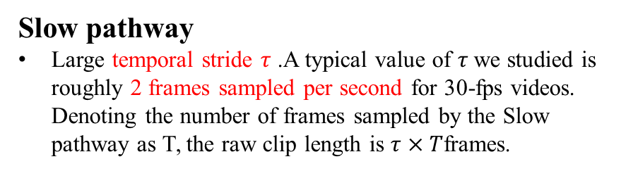
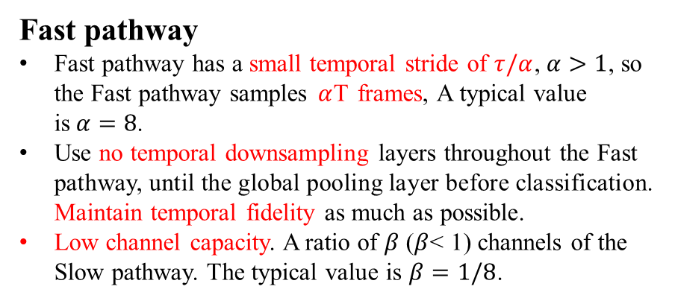
Architecture
Slow pathway
Large temporal stride $τ$ .A typical value of $τ$we studied is roughly 2 frames sampled per second for 30-fps videos. Denoting the number of frames sampled by the Slow pathway as T, the raw clip length is $τ×T$frames.
Fast pathway
Fast pathway has a small temporal stride of $τ/α$, $α>1$, so the Fast pathway samples$α$T frames, A typical value is$α=8$.
Use no temporal downsampling layers throughout the Fast pathway, until the global pooling layer before classification. Maintain temporal fidelity as much as possible.
Low channel capacity. A ratio of $β$ ($β$< 1) channels of the Slow pathway. The typical value is $β=1/8$.
Slow pathway, operate at low frame rate, capture spatial semantics.
Fast pathway, operate at high frame rate, to capture motion at fine temporal resolution.
Fast pathway can be made very lightweight(20% of total computation) by reducing its channel capacity, yet can learn useful temporal information for video recognition.
Lateral connections
The information of the two pathways is fused by lateral connections. The two pathways have different temporal dimensions, so the lateral connections perform a transformation to match them.

Slide 21
Instantiations
we use non-degenerate temporal convolutions (temporal kernel size > 1) only in res4 and res5. Filters from conv1 to res3 are essentially 2D convolution kernels in this pathway.
This is motivated by our experimental observation that using temporal convolutions in earlier layers degrades accuracy.
The Fast pathway has non-degenerate temporal convolutions in every block.
This is motivated by the observation that this pathway holds fine temporal resolution for the temporal convolutions to capture detailed motion.

Slide 22
Experiments

Slide 23
Conclusion
Spatio-temporally Action Detection is an important step in video understanding but it is also a very challenging task.
AVA is a well-annotated data set with many advantages that other data sets do not have. But at present, many detection algorithms have not achieved breakthrough effect.
The diversity of AVA annotation makes it more exploitable. More tasks can be done on this data set, such as character relationship detection, and so on.

